Slide 1
Project report for Big Mountain resort
Felipe Nuñez Villena, PhD
01-07-2020

Slide 2
Big Mountain resort facts
It is located in northwestern Montana
Offers access to 105 named trailes
Transport within the resort: 11 lifts, 2 T-bars and 1 magic carpet

Slide 3
Latest investment
Installation of an additional chair lift to increase the distribution of visitors acroos the mountain.
The problem - Novel installation results in an increase of operating costs by 1.540.000
Is it possible to justify a rise in the price of adult weekend tickets to compensate money invested in the chair lift ?

Slide 4
Key findings & Recomendations
Dataset characteristics
Information about 330 ski resorts in the US.
Variables - location, mountain information, transport within the resort, ticket price, length of the season, among others.
The price of adults during the weekend is only moderated explained by the features present in the dataset.
Explanatory variables with the highest relevance are related to the length of the season and mountain geographical features rather than transporting facilities within the resort.
Key findings
Seems not justified to increase the ticket price of adults during the weekend. Therefore, to compensate the investment, a decrease in the chair lift operating costs should be considered.
Recomendations

Slide 5
Modeling results and analysis
Dataset characteristics: 330 entries and 27 features.
Data Cleaning: Removal of outliers and highly correlated features. Processed dataset contain: 167 entries and 26 features.
Response variable: Price of adult tickets during the weekend.
Dataset description and cleaning

Slide 6
Modeling results and analysis
Counts
Distribution of ticket prices
among US ski resorts
Adult price weekdays
Adult price weekends
During weekdays: Most the resorts charge between 20 – 60 dollars. A small fraction charge prices up to aprox 90 dollars
During weekends: range of prices is similar ( 20 – 90 dollars). However, the distribution is not the same. Prices are more spread during the weekend. Interestingly, 1 population of resorts charge between 40-50 dollars and a second population charge prices higher than 60 dollars.
Are there any explanatory variables for the change in the price
Distribution during the weekend ?

Slide 7
Modeling results and analysis
High association between adultprice Weekday and
Weekends tickets
Correlation plots between price tickets
And days open last year and the
Prediction for the current year.
Variables such as daysOpenLastYear and PredictedDaysOpen displayed a
poor correlation with the response variable AdultWeekday (prices).
- Others explanatory variables with more importance in this dataset ?

Slide 8
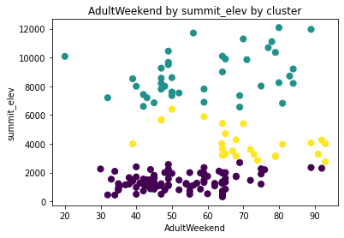
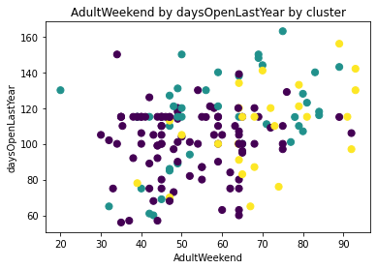
Modeling results and analysis
Results Performance metrics
Predicted AdultWeekend price = 56.15 Explained Variance Score = 0.71
Current AdultWeekend price = 81.0 Mean Absolute Error = 5.22
Response variable against high importance features
Most relevant variables
1 - AdultWeekday (11.2)
2 - clusters (2.9)
3 - summit_elev (2.56)
4 - daysOpenLastYear (2.45)
5 – SkiableTerrain_ac (2.22)
6 – Runs (1.96)
7 – projectedDaysOpen(1.95)
8 – Vertical_drop (1.76)
Machine learning model results
Correlation between the features with the
highest relevance and the response variable
are poor.

Slide 9
Summary
The model predicted that the adult ticket price during the weekend should a 30% cheaper.
The variables present in the dataset moderately explain the outcome of the response variable (AdultWeekend).
High importance features predicted by the model include length of the season and mountain geographical characteristics.
Transport variables do no exhibit high relevance in this model.

